Slide 1
Cognitive, Behavioral, and Social Data
Michele Zanatta, Brenda Tellez, Endrit Sveçla, Gita Andadari

Slide 2
Introduction: in this presentation
Overview of the procedure
Feature selection model dependent methods
Feature importance model agnostic methods
Discussion of the obtained results

Slide 3
Datasets and preprocessing
For many datasets there is no need of preprocessing

Slide 4
Metrics
Accuracy to evaluate the models
Jaccard similarity to compare the selected features

Slide 5
Models
Logistic Regression
Random Forest
SVM
kNN

Slide 6
Procedure
Fit the models with 100% of features;
Apply model dependent features selection method and take the 20% best features. Fit the models with this set of features;
Select 20% best features based on coefficients values (just for interpretable models);
Apply model agnostic and model independent features selection methods, taking the 20% best features. Fit the models with this set of features;
Compare the results.

Slide 7
Model Dependent Feature Selection
Model-dependent feature selection attempts to perform the selection and the processing of the data simultaneously.
Methods:
Forward Selection
Is a type of stepwise regression which begins with an empty model and adds in variables one by one.
SelectFromModel Method
The SelectFromModel is a meta-estimator that determines the weight importance by comparing to the given threshold value.
It requires an estimator that must have attributes to provide the indexes of selected data.

Slide 8
Results of these methods from one dataset
Accuracies(%) on the test set of DT_df_CC.csv dataset from shortTD
Method/Model | Lin. Regression | Random Forest | SVM | kNN
Full Model | 0.734694 | 0.755102 | 0.755102 | 0.693878
20% Forward Selection | 0.77551 | 0.653061 | 0.693878 | 0.714286
20% Model Selection | 0.755102 | 0.714286 | None | None

Slide 9
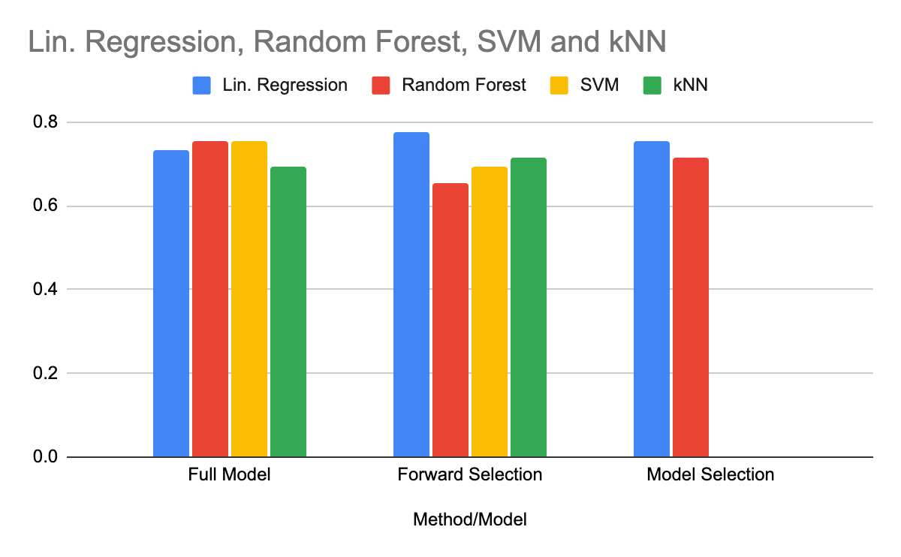
Results of these methods from one dataset
Accuracies(%) on the test set of DT_df_CC.csv dataset from shortTD

Slide 10
Chi Square
We calculate Chi-square between each feature and the target and select the desired number of features with best Chi-square scores.
It determines if the association between two categorical variables of the sample would reflect their real association in the population.

Slide 11
Model Independent Feature Selection
Filter-Based Feature Selection Methods
Use correlation type statistical measures between input and output variables as the basis for filter feature selection.
Categorical variables
Likert Scale
Honest, Dishonest classification
Methods:
Chi Square
Mutual Information

Slide 12
Mutual Information
Entropy of a random variable is the average level of "information", "surprise", or "uncertainty".
Mutual Information (Information Gain) calculates the statistical dependence between two variables to find the reduction in entropy from transforming a dataset in some way.
Feature selection: by evaluating the gain of each variable in the context of the target variable and pick the ones with the most information.

Slide 13
Model Agnostic Methods
Separate the explanations from the machine learning model.
Advantages of model-agnostic interpretation methods:
Model flexibility
Explanation flexibility
Representation flexibility

Slide 14
Permutation Importance
Permutation feature importance measures the increase in the prediction error of the model after we permuted the feature’s values, which breaks the relationship between the feature and the true outcome.
A feature is “important” if shuffling its values increases the model error, because in this case the model relied on the feature for the prediction
A feature is “unimportant” if shuffling its values leaves the model error unchanged, because in this case the model ignored the feature for the prediction.

Slide 15
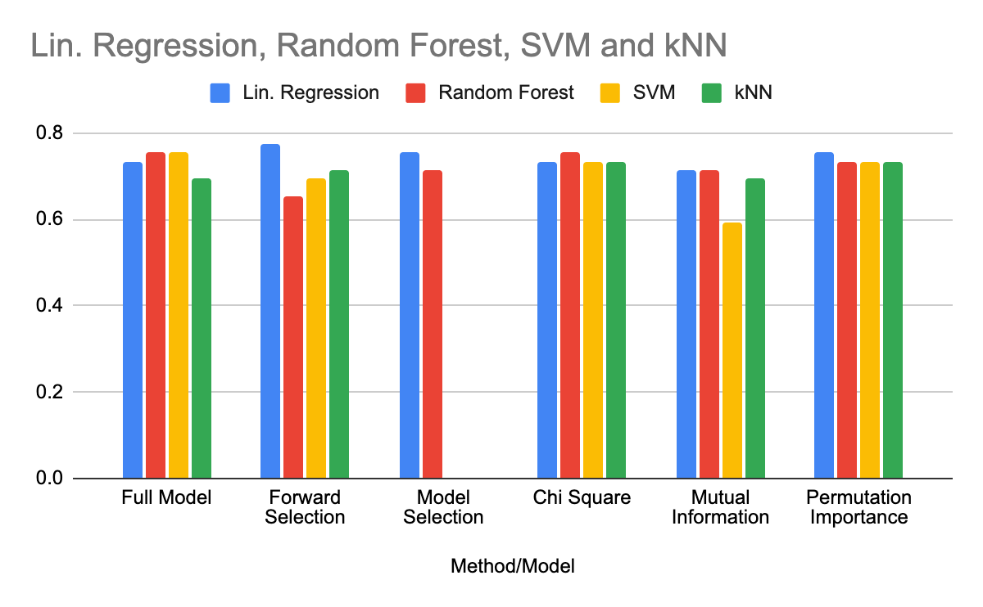
Results of these methods from one dataset
Accuracies(%) on the test set of DT_df_CC.csv dataset from shortTD (faking good)
Notes:
Proud of your graph :)

Slide 16
Results of these methods from one dataset
Accuracies(%) on the test set of DT_df_CC.csv dataset from shortTD (faking good)
Method/Model | Lin. Regression | Random Forest | SVM | kNN
Full Model | 0.734694 | 0.755102 | 0.755102 | 0.693878
Forward Selection | 0.77551 | 0.653061 | 0.693878 | 0.714286
Model Selection | 0.755102 | 0.714286 | None | None
Chi Square | 0.734694 | 0.755102 | 0.734694 | 0.734694
Mutual Information | 0.714286 | 0.714286 | 0.591837 | 0.693878
Permutation Importance | 0.755102 | 0.734694 | 0.734694 | 0.734694

Slide 17
Results

Slide 18
Diverse ML models with equal accuracy has different set of feature that the model deemed important
PHQ9_GAD7.csv | lr | rf | svm | knn
100% | 100% | 100% | 100% | 98%
20% forward selection | 97% | 99% | 98% | 98%
20% model selection | 96% | 99%
chi2 | 99% | 99% | 99% | 99%
permutation importance | 99% | 96% | 96% | 99%
mutual information | 99% | 100% | 99% | 99%
 | PHQ9_GAD7
forward selection | 0,8125
model selection | 0,6
permutation important | 0,55
Jaccard Distance

Slide 19
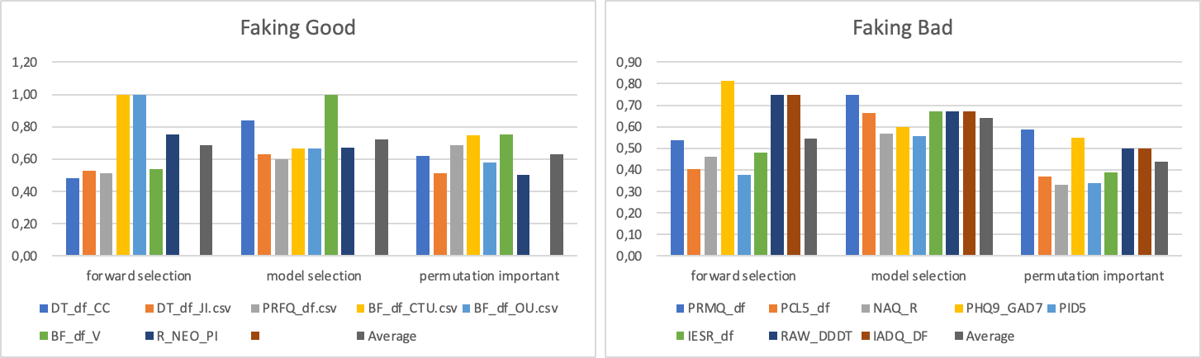
And the behaviour is consistent across all datasets
So far, we have not notice a significant difference of performance between faking good and faking bad datasets.
Jacard Distance

Slide 20
Overall Accuracy
Reducing 80% of the feature in most model selection method did not increase the accuracy of the prediction on the test set.
However, the accuracy decrease is relatively small.
On the other hand, reducing features decrease the training time quite significantly especially for datasets with large number of features.
Method | Average Accuracy
100% | 0,839333333
20% forward selection | 0,827333333
20% model selection | 0,831333333
chi2 | 0,842666667
permutation importance | 0,826
mutual information | 0,772666667

Slide 21
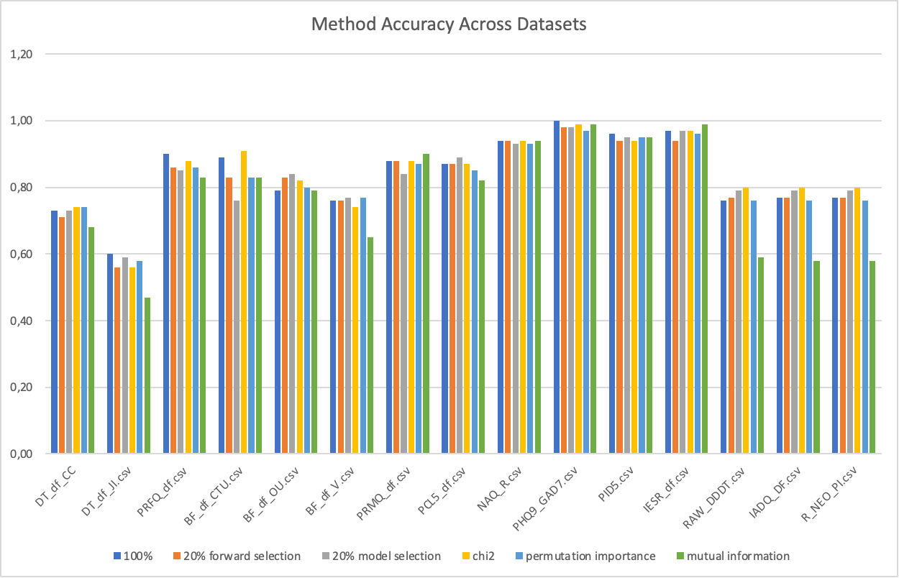
Model agnostic vs Model Independent vs Model Dependent
All proposed methods produce similar accuracy for each datasets

Slide 22
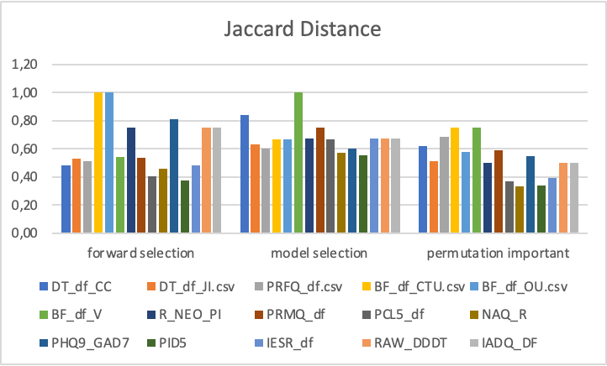
Model agnostic vs Model Independent vs Model Dependent
Despite similar accuracy, different methods still produce different set of features for each dataset when different model is being used.
Based on our experiment, model selection give the most consistent feature selection despite the chosen model.
Since model independent method (chi and mutual information) only produce one set of features, need to come up with a new metric to compare this method to another method.
In general, model dependent still works better in producing consistent features compare to model agnostic method.

Slide 23
Future Plan
Come up with a metric that can compare “Model Independent”, “Model Agnostic”, and “Model Dependent” methods
Jaccard distance of model independent cannot be produced
Finding significant different among faking good and faking bad datasets
Since the current proposed method stability across all datasets is low, we plan to explore another avenue such as PCA

